Slide 1
QND Computer Science
Day 0
Mark Schmidt

Slide 2
Agenda
- Introduction
- Why Computer Science?
- What is a program?
- Activity

Slide 3
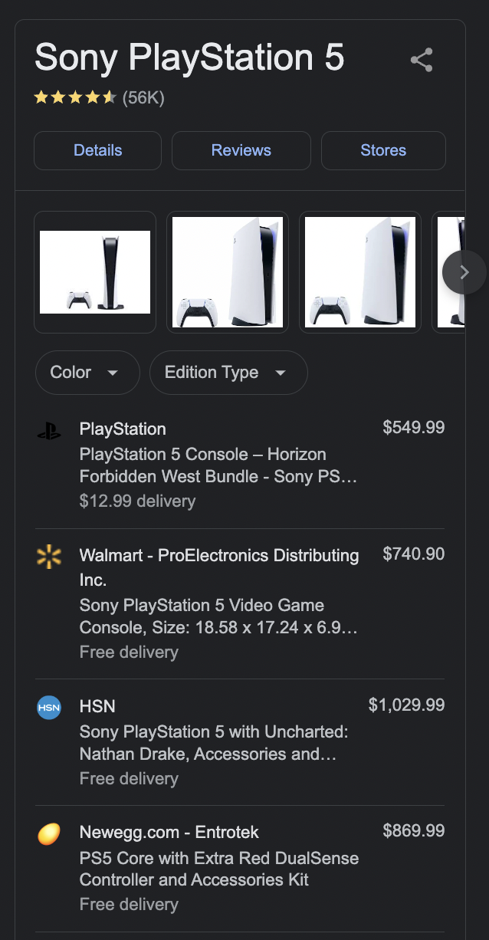
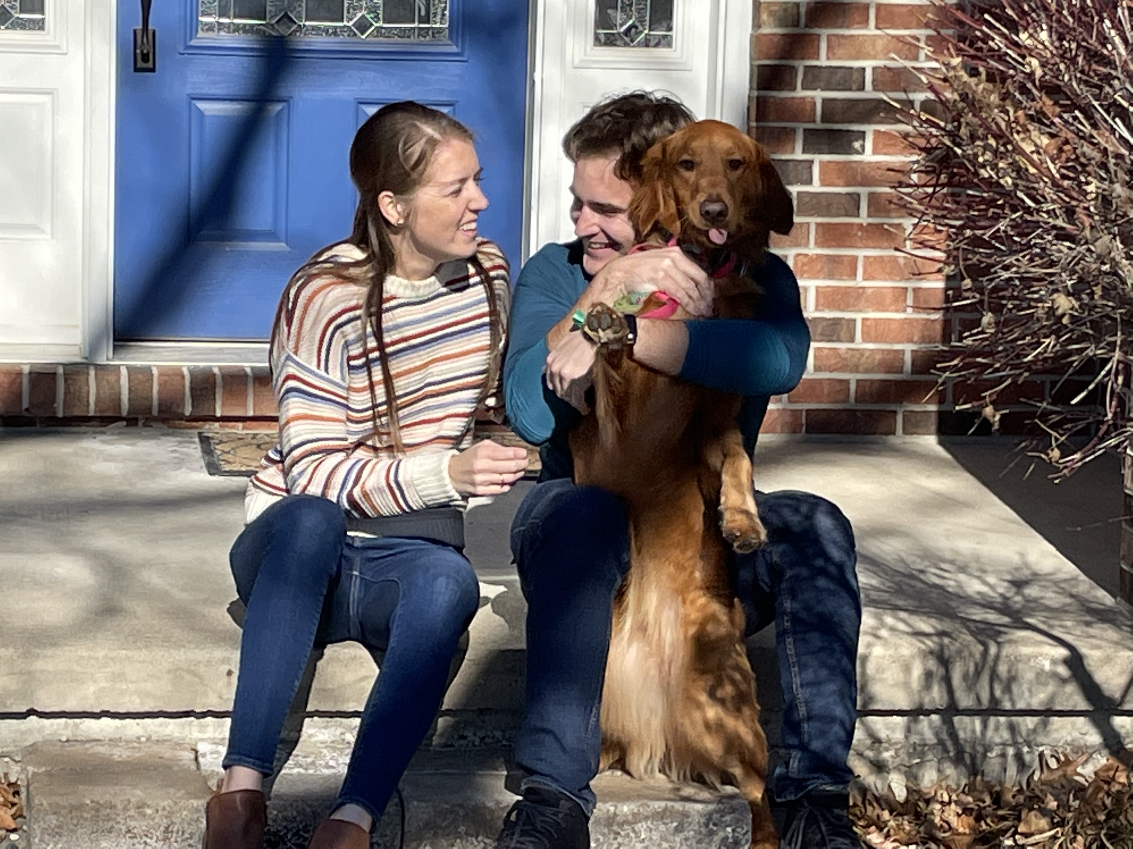
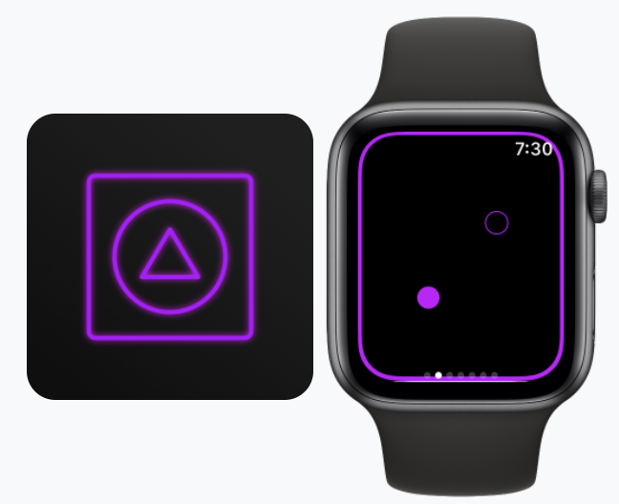
Background

Slide 4
What is this course?
Provide foundational knowledge
Learn through projects
Mentorship + guidance

Slide 5
Why Computer Science?
Great career opportunities
Creative, self driven field
Differentiator for any job
Understand the digital world
Computer science is for everyone!
It’s really fun!

Slide 6
A Warning
I’m going to lie to you
Black boxes

Slide 7
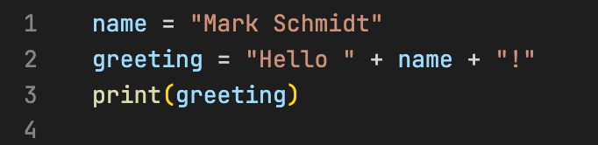
The Basics
What is a program?
A sequence of instructions for a computer
Write programs in a programming language
A compiler or interpreter converts programming language to machine code
Your computer can execute the machine code

Slide 8
Program Execution
The computer will do exactly what you tell it to do
Sometimes, this does what you want
Sometimes, it does not
Making mistakes is common!
It’s part of the fun!

Slide 9

Your First Program!
Write a program with instructions to make a PB+J sandwich
Groups of 3
Write your name(s) on the top of the page, then a list of instructions
Be specific! I will do EXACTLY what you instruct
4 minutes

